Slide 1
Cryptographic Tools

Slide 2
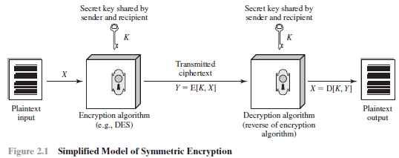
Confidentiality with Symmetric Encryption
Symmetric encryption also referred to as conventional encryption or single-key encryption.
Plaintext: This is the original message or data that is fed into the algorithm as input.
Encryption Algorithm: The encryption algorithm performs various substitutions and transformations on the plaintext.
Secret key: The secret key is also input to the encryption algorithm.
Ciphertext: This is the scrambled message produced as output.
Decryption Algorithm: It takes the ciphertext and the secret key and produces the original plaintext.

Slide 3
Confidentiality with Symmetric Encryption
There are two requirements for secure use of symmetric encryption:
1. We need a strong encryption algorithm. At a minimum, we would like the algorithm to be such that an opponent who knows the algorithm and has access to one or more ciphertexts would be unable to decipher the ciphertext or figure out the key.
This requirement is usually stated in a stronger form:
The opponent should be unable to decrypt ciphertext or discover the key even if he or she is in possession of a number of ciphertexts together with the plaintext that produced each ciphertext.
2. The sender and receiver must have obtained copies of the secret key in a secure fashion and must keep the key secure. If someone can discover the key and knows the algorithm, all communication using this key is readable.

Slide 4
Confidentiality with Symmetric Encryption
There are two general approaches to attacking a symmetric encryption scheme.
1. Cryptanalysis: Cryptanalytic attacks rely on the nature of the algorithm plus perhaps some knowledge of the general characteristics of the plaintext.
This type of attack exploits the characteristics of the algorithm to attempt to deduce a specific plaintext or to deduce the key being used.
If the attack succeeds in deducing the key, the effect is catastrophic: All future and past messages encrypted with that key are compromised.
2. Brute-Force Attack: Try every possible key on a piece of ciphertext until an intelligible translation into plaintext is obtained. On average, half of all possible keys must be tried to achieve success. That is, if there are x different keys, on average an attacker would discover the actual key after x/2 tries.

Slide 5
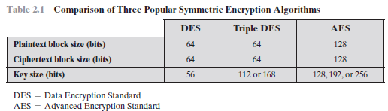
Symmetric Block Encryption Algorithm
The most commonly used symmetric encryption algorithms are block ciphers.
Block Ciphers: A block cipher processes the plaintext input in fixed-size blocks and produces a block of ciphertext of equal size for each plaintext block.
The algorithm processes longer plaintext amounts as a series of fixed-size blocks.
The most important symmetric algorithms, all of which are block ciphers, are :Data Encryption Standard (DES),Triple DES,Advanced Encryption Standard (AES).

Slide 6
Symmetric Block Encryption Algorithm
DES (Data Encryption Standard): DES takes a plaintext block of 64 bits and a key of 56 bits, to produce a ciphertext block of 64 bits.Strength of DES fall into two categories: concerns about the algorithm itself, and concerns about the use of a 56-bit key.
3-DES: The life of DES was extended by the use of triple DES (3DES), which involves repeating the basic DES algorithm three times, using either two or three unique keys, for a key size of 112 or 168 bits.
3DES has two attractions that assure its widespread use over the next few years.
1. 168-bit key length, it overcomes the vulnerability to brute-force attack of DES.
2. the underlying encryption algorithm in 3DES is the same as in DES.

Slide 7
Symmetric Block Encryption Algorithm
Drawback of 3DES:
The principal drawback of 3DES is that the algorithm is relatively sluggish in software.
The original DES was designed for mid-1970s hardware implementation and does not produce efficient software code.
3DES which requires three times as many calculations as DES, is correspondingly slower.
A secondary drawback is that both DES and 3DES use a 64-bit block size. For reasons of both efficiency and security, a larger block size is desirable.

Slide 8
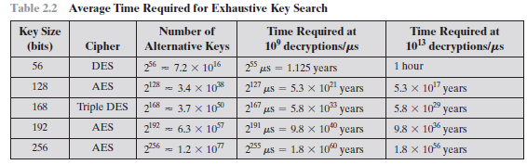
Symmetric Block Encryption Algorithm
AES ( Advanced Encrytion Standard):Because of its drawbacks, 3DES is not a reasonable candidate for long-term use.
NIST specified that AES must be a symmetric block cipher with a block length of 128 bits and support for key lengths of 128, 192, and 256 bits.
Evaluation criteria included security, computational efficiency, memory requirements, hardware and software suitability, and flexibility.
Table 2.2 shows how much time is required for a brute-force attack for various key sizes.

Slide 9
Symmetric Block Encryption Algorithm - Practical Security Issues
Symmetric encryption is applied to a unit of data larger than a single 64-bit or 128-bit block.
E-mail messages, network packets, database records, and other plaintext sources must be broken up into a series of fixed length block for encryption by a symmetric block cipher.
The simplest approach to multiple-block encryption is known as electronic codebook (ECB) mode, in which plaintext is handled ‘b’ bits at a time and each block of plaintext is encrypted using the same key. Typically b = 64 or b = 128.

Slide 10
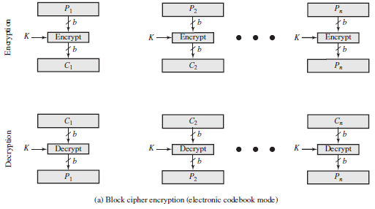
Symmetric Block Encryption Algorithm - Practical Security Issues
Figure 2.2a shows the ECB mode. A plain text of length ‘nb’ is divided into n b-bit blocks (P1, P2,c, Pn). Each block is encrypted using the same algorithm and the same encryption key, to produce a sequence of n b-bit blocks of ciphertext (C1, C2,c, Cn)..
To increase the security of symmetric block encryption for large sequences of data, a number of alternative techniques have been developed, called modes of operation. These modes overcome the weaknesses of ECB.

Slide 11
Symmetric Block Encryption Algorithm - Stream Ciphers
A block cipher processes the input one block of elements at a time, producing an output block for each input block.
A stream cipher processes the input elements continuously, producing output one element at a time, as it goes along.
A typical stream cipher encrypts plaintext one byte at a time, although a stream cipher may be designed to operate on one bit at a time or on units larger than a byte at a time.

Slide 12
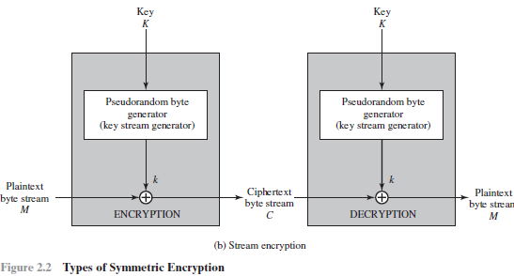
Symmetric Block Encryption Algorithm - Stream Ciphers
Figure 2.2b is a representative diagram of stream cipher structure.
A key is input to a pseudorandom bit generator that produces a stream of 8-bit numbers that are apparently random.
A pseudorandom stream is one that is unpredictable without knowledge of the input key and which has an apparently random character. The output of the generator, called a keystream, is combined one byte at a time with the plaintext stream using the bitwise exclusive-OR (XOR) operation.

Slide 13
Message Authentication and Hash Function
Encryption protects against passive attack (eavesdropping). A different requirement is to protect against active attack (falsification of data and transactions). Protection against such attacks is known as message or data authentication.
The two important aspects are to verify that the contents of the message have not been altered and that the source is authentic.
We may also wish to verify a message’s timeliness (it has not been artificially delayed and replayed) and sequence relative to other messages flowing between two parties.

Slide 14
Authentication Using Symmetric Encryption
If we assume that only the sender and receiver share a key, then only the genuine sender would be able to encrypt a message successfully for the other participant, provided the receiver can recognize a valid message.
If the message includes an error-detection code and a sequence number, the receiver is assured that no alterations have been made and that sequencing is proper.
If the message also includes a timestamp, the receiver is assured that the message has not been delayed beyond that normally expected for network transit.

Slide 15
Authentication Using Symmetric Encryption
Symmetric encryption alone is not a suitable tool for data authentication.
In ECB mode of encryption, if an attacker reorders the blocks of ciphertext, then each block will still decrypt successfully.
The reordering may alter the meaning of the overall data sequence.
Although sequence numbers may be used at some level (e.g., each IP packet), it is typically not the case that a separate sequence number will be associated with each b-bit block of plaintext.
Thus, block reordering is a threat.

Slide 16
Message Authentication without Message Encryption
message authentication is provided as a separate function from message encryption. There are three situations in which message authentication without confidentiality is preferable:
1. There are a number of applications in which the same message is broadcast to a number of destinations. Two examples are notification to users that the network is now unavailable, and an alarm signal in a control center.
2. Another possible scenario is an exchange in which one side has a heavy load and cannot afford the time to decrypt all incoming messages. Authentication is carried out on a selective basis, with messages being chosen at random for checking.
3. Authentication of a computer program in plaintext is an attractive service. The computer program can be executed without having to decrypt it every time, which would be wasteful of processor resources. However, if a message authentication tag were attached to the program, it could be checked whenever assurance is required of the integrity of the program

Slide 17
Messae Authentication Code
One authentication technique involves the use of a secret key to generate a small block of data, known as a message authentication code, that is appended to the message.
This technique assumes that two communicating parties, say A and B, share a common secret key KAB.
When A has a message to send to B, it calculates the message authentication code as a complex function of the message and the key:
The message plus code are transmitted to the intended recipient.
The recipient performs the same calculation on the received message, using the same secret key, to generate a new message authentication code.

Slide 18
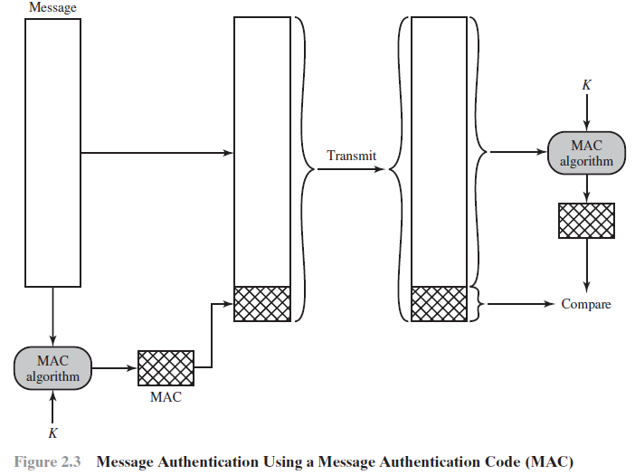
Message Authentication Code
The received code is compared to the calculated code as shown in Figure 2.3.

Slide 19
Message Authentication Code
If we assume that only the receiver and the sender know the identity of the secret key, and if the received code matches the calculated code, then:
1. The receiver is assured that the message has not been altered. If an attacker alters the message but does not alter the code, then the receiver’s calculation of the code will differ from the received code.
2. The receiver is assured that the message is from the alleged sender. Because no one else knows the secret key and cannot prepare a message with a proper code.
3. If the message includes a sequence number, then the receiver can be assured of the proper sequence, because an attacker cannot successfully alter the sequence number.

